Slide 1

Neural Networks
Note to other teachers and users of these slides: We would be delighted if you found our
material useful for giving your own lectures. Feel free to use these slides verbatim, or to
modify them to fit your own needs. If you make use of a significant portion of these slides
in your own lecture, please include this message, or a link to our web site: http://www.mmds.org
CS246: Mining Massive Datasets
Jure Leskovec, Stanford University
Mina Ghashami, Amazon
http://cs246.stanford.edu
Notes:
Embedding makes it easier to do ML on large inputs, we will define embeddings, explain why ML methods benefit from embedding, and discuss few ways of producing embedding.

Slide 2
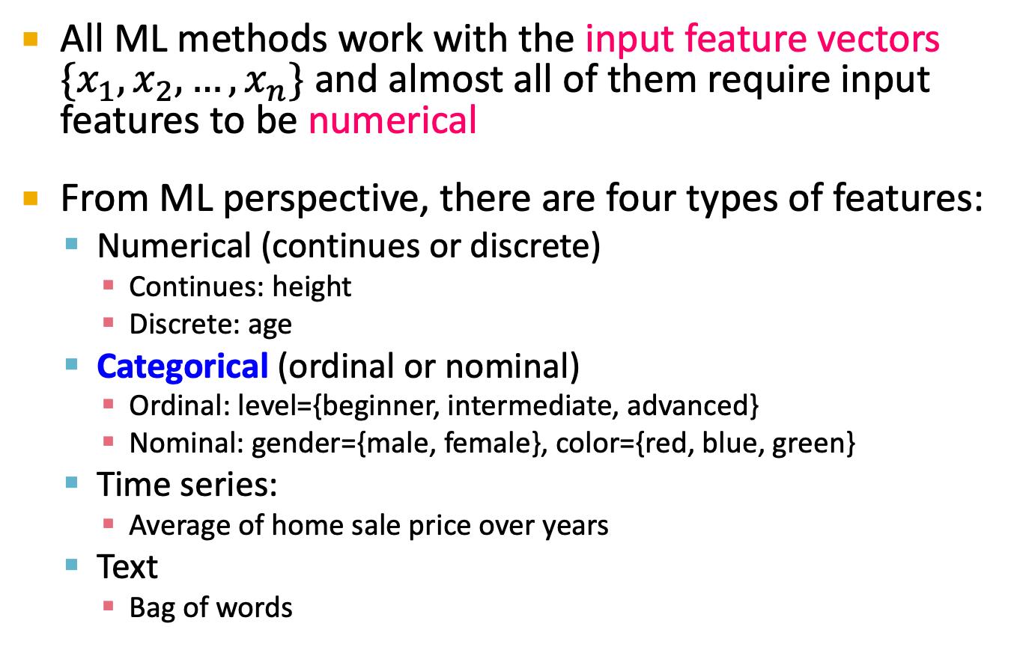
Input Feature Vectors
All ML methods work with the input feature vectors $\{x_{1}, x_{2}, …, x_{n}\}$ and almost all of them require input features to be numerical
From ML perspective, there are four types of features:
Numerical (continues or discrete)
Continues: height
Discrete: age
Categorical (ordinal or nominal)
Ordinal: level={beginner, intermediate, advanced}
Nominal: gender={male, female}, color={red, blue, green}
Time series:
Average of home sale price over years
Text
Bag of words
Notes:
Example of methods without this requirement:
Decision Trees, Random Forest, Boosted Trees
A lot of effort in deploying ML algorithms goes into the design of preprocessing pipelines and data transformations
Different representations can entangle and hide different explanatory factors of data
that result in a representation of the data that can support effective machine learning.
feature engineering is important but labor-intensive
Able to extract and organize the discriminative information from the data.
-------
https://towardsdatascience.com/data-types-from-a-machine-learning-perspective-with-examples-111ac679e8bc
Numerical data can be characterized by continuous or discrete data. Continuous data can assume any value within a range whereas discrete data has distinct values.
The takeaway here is that numerical data is not ordered in time. They are just numbers that we have collected.
Categorical data represents characteristics, such as a hockey player’s position, team, hometown. Categorical data can take numerical values. For example, maybe we would use 1 for the colour red and 2 for blue. But these numbers don’t have a mathematical meaning. That is, we can’t add them together or take the average.
In the context of super classification, categorical data would be the class label. This would also be something like if a person is a man or woman, or property is residential or commercial.
There is also something called ordinal data, which in some sense is a mix of numerical and categorical data. In ordinal data, the data still falls into categories, but those categories are ordered or ranked in some particular way. An example would be class difficulty, such as beginner, intermediate, and advanced. Those three types of classes would be a way that we could label the classes, and they have a natural order in increasing difficulty.
Time series data is a sequence of numbers collected at regular intervals over some period of time. It is very important, especially in particular fields like finance. Time series data has a temporal value attached to it, so this would be something like a date or a timestamp that you can look for trends in time.
For example, we might measure the average number of home sales for many years. The difference of time series data and numerical data is that rather than having a bunch of numerical values that don’t have any time ordering, time-series data does have some implied ordering. There is a first data point collected and the last data point collected.

Slide 3
Categorical Features
There are two ways to encode categorical var:
Integer encoding
One-hot encoding (and multi-hot encoding)
Consider the following movie dataset:
Title | provider | IMDB genres | Release year | IMDB rating
Stranger Things | Netflix | drama, fantasy, horror | 2016 | 8.7
Cocomelon | Prime Video | animation, comedy, family | 2019 | 4.7
100 Foot Waves | HBO Max | documentary, sport | 2021 | 8.1
I, Tonya | Hulu | biography, drama, comedy | 2017 | 7.5

Slide 4
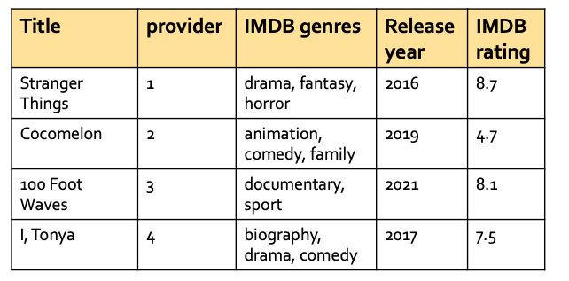
Integer Encoding
Assigns each category value with an integer
provider :=[Netflix, Prime Video, HBO Max, Hulu], we assign them integers 1, 2, 3 and 4 respectively.
Pros: dense representation
Cons: It implies ordering
between different categories:
Netflix < Prime Video < HBO Max < Hulu
Makes more sense to use it for ordinal variables:
Such as “Education”= {Diploma, Undergrad, Masters, PhD }
But still it implies values are equally spaced out

Slide 5
One-hot Encoding
First do integer encoding, then create a binary vector that represents the numerical values
Ex: following integer encoding on provider:
Netflix -> 1, Prime Video -> 2, HBO Max ->3 , Hulu -> 4
create a binary vector of length 4 for each value:
Netflix
1 | 0 | 0 | 0
Prime Video
0 | 1 | 0 | 0
The integer encoding is the index into the vector
HBO Max
0 | 0 | 1 | 0
Hulu
0 | 0 | 0 | 1

Slide 6
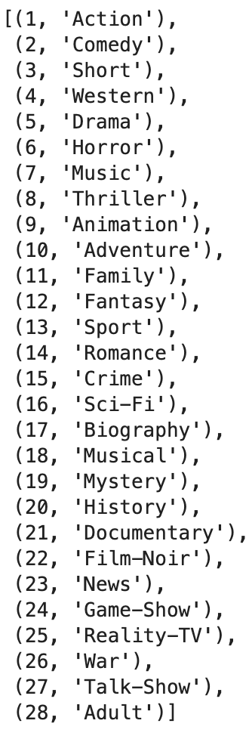
Multi-hot Encoding
IMDB genres
An extension of one-hot encoding when categorical variable can take multiple
values at the same time
Ex: There are 28 distinct IMDB genres
a movie can take multiple genres, e.g. stranger things
is drama, fantasy, horror.
Stranger things
0 | 0 | 0 | 0 | 1 | 1 | 0 | 0 | 0 | 0 | 0 | 1 | 0 | 0 | 0 | 0 | 0 | 0 | 0 | 0 | 0 | 0 | 0 | 0 | 0 | 0 | 0 | 0
Cocomelon
0 | 1 | 0 | 0 | 0 | 0 | 0 | 0 | 1 | 0 | 1 | 0 | 0 | 0 | 0 | 0 | 0 | 0 | 0 | 0 | 0 | 0 | 0 | 0 | 0 | 0 | 0 | 0
100 foot wave
0 | 0 | 0 | 0 | 0 | 0 | 0 | 0 | 0 | 0 | 0 | 0 | 1 | 0 | 0 | 0 | 0 | 0 | 0 | 0 | 1 | 0 | 0 | 0 | 0 | 0 | 0 | 0
I, Tonya
0 | 1 | 0 | 0 | 1 | 0 | 0 | 0 | 0 | 0 | 0 | 0 | 0 | 0 | 0 | 0 | 1 | 0 | 0 | 0 | 0 | 0 | 0 | 0 | 0 | 0 | 0 | 0

Slide 7
Applying encodings on Movies dataset
provider
IMDB genres
Data dimensions increased from 5 to 35. It will blow up to thousands or a million if we multi-hot encode title!
One-hot and multi-hot encodings are not practical for features with large value sets.
Stranger things
1 | 0 | 0 | 0 | 0 | 0 | 0 | 0 | 1 | 1 | 0 | 0 | 0 | 0 | 0 | 1 | 0 | 0 | 0 | 0 | 0 | 0 | 0 | 0 | 0 | 0 | 0 | 0 | 0 | 0 | 0 | 0
2016 | 8.7
cocomelon
0 | 1 | 0 | 0 | 0 | 1 | 0 | 0 | 0 | 0 | 0 | 0 | 1 | 0 | 1 | 0 | 0 | 0 | 0 | 0 | 0 | 0 | 0 | 0 | 0 | 0 | 0 | 0 | 0 | 0 | 0 | 0
2019 | 4.7
100 foot waves
0 | 0 | 1 | 0 | 0 | 0 | 0 | 0 | 0 | 0 | 0 | 0 | 0 | 0 | 0 | 0 | 1 | 0 | 0 | 0 | 0 | 0 | 0 | 0 | 1 | 0 | 0 | 0 | 0 | 0 | 0 | 0
2021 | 8.1
I, Tonya
0 | 0 | 0 | 1 | 0 | 1 | 0 | 0 | 1 | 0 | 0 | 0 | 0 | 0 | 0 | 0 | 0 | 0 | 0 | 0 | 1 | 0 | 0 | 0 | 0 | 0 | 0 | 0 | 0 | 0 | 0 | 0
2017 | 7.5

Slide 8
From encoding to embedding
One-hot/multi-hot encodings:
pros: simple, robust, the observation that simple models trained on huge amounts of data outperform complex systems trained on less data
cons: sparse and high dimensional, does not capture semantic similarity
In a corpus of documents with one million distinct words:
high dimensional: multi-hot encodings are 1-million dimensional
Sparse: an average document contains 500 words therefore the multi-hot encodings are > 99.95% sparse
lack of semantic: encoding of two words ‘good’ and ‘great’ are as different as encoding of ‘good’ and ‘bad’!
An embedding is a translation of a high-dim vector into a low-dim space. An embedding is a:
Dense representation (floating-point value)
Low-dimensional vector
Captures semantic similarity
Notes:
floating-point value between 0 and 1

Slide 9
Review: SVD as an embedder
Standard dimensionality Reduction methods
Singular value decompositions (SVD)
A: Input data matrix: m x n matrix (e.g., m documents, n terms)
(r : rank of the matrix A – often r < min(m,n) )
U: Left singular vectors: m x r matrix (m documents, r concepts)
Σ: Singular values: r x r diagonal matrix (strength of each ‘concept’)
V: Right singular vectors: n x r matrix (n terms, r concepts)
n
r
r
n
A
U
×
Σ
×
V^{T}
r
m
=

Slide 10
Random vector x
Step1: Ax
Step 2: Normalize it: x = Ax/|Ax| → x is of unit norm
Repeat step 1 and 2

Slide 11
Review: SVD as an embedder
U, V: column orthonormal
U^{T} U = I; V^{T} V = I (I: identity matrix)
Columns are orthogonal unit vectors hence they define an r-dimensional subspace
U defines an r-dim subspace in R^{m}
V defines an r-dim subspace in R^{n}
Projecting A onto V and U produces embeddings:
Since A = U Σ V^{T} then AV = U Σ are row embeddings
Since A = U Σ V^{T} then U^{T}A = Σ V^{T} are col embeddings

Slide 12
Review: SVD as an embedder
Ex: compute document & word embeddings
Step 1: given a corpus of documents convert it to BOW vectors → get a term-document matrix
Use term frequencies (tf), or normalize using tf-idf
 | data | science | spark | Stanford | learning
document 1 | 10 | 15 | 3 | 0 | 10
document 2 | 0 | 9 | 2 | 8 | 2
document 3 | 1 | 2 | 20 | 0 | 4
document 4 | 14 | 11 | 1 | 32 | 2
document 5 | 5 | 1 | 7 | 12 | 5
document 6 | 6 | 3 | 5 | 1 | 1
document 7 | 2 | 3 | 5 | 2 | 7

Slide 13

Review: SVD as an embedder
Step 2: apply SVD on the term-document matrix
and pick a value $r≤rank(A)$
Here, we set r = 3.
10 15 3 0 10 0 9 2 8 2
1 2 20 0 4
14 11 1 32 2
5 1 7 12 5 6 3 5 1 1
2 3 5 2 7
-0.30 0.41 -0.79
-0.25 0.03 -0.12
-0.14 0.74 0.5
-0.83 -0.40 0.12
-0.33 0.11 0.31
-0.13 0.20 -0.04
-0.14 0.27 -0.05
Σ
42.7 0 0
0 23.8 0
0 0 16.7
~
x
x
-0.41 -0.40 -0.20 -0.77 -0.20
0.06 0.21 0.78 -0.45 0.37
-0.26 -0.63 0.55 0.40 -0.28
A
U
V^{T}

Slide 14
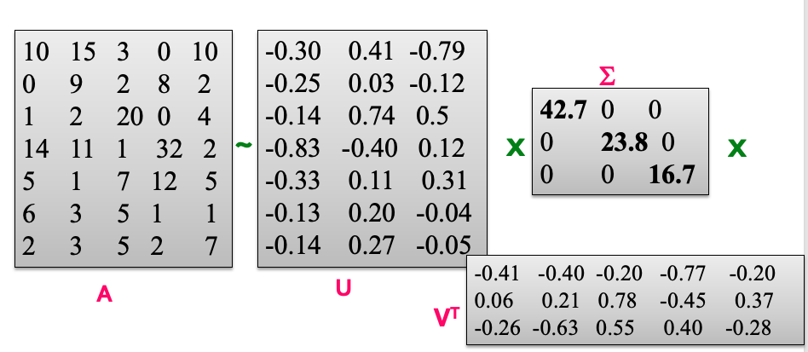
Review: SVD as an embedder
Step 3: compute embedding of documents as emb = [<doc, v1> , <doc, v2> , <doc, v3>]
<doc, v1> = <[10,15,3,0,10] , v1>= -12.7
doc

Slide 15
Review: SVD as an embedder
Step 3: compute embedding of documents as emb = [<doc, v1> , <doc, v2> , <doc, v3>]
<doc, v1> = <[10,15,3,0,10] , v1>= -12.7
<doc, v2> = <[10,15,3,0,10] , v2> = 9.79
doc

Slide 16
Review: SVD as an embedder
Step 3: compute embedding of documents as emb = [<doc, v1> , <doc, v2> , <doc, v3>]
<doc, v1> = <[10,15,3,0,10] , v1>= -12.7
<doc, v2> = <[10,15,3,0,10] , v2> = 9.79
<doc, v3> = <[10,15,3,0,10] , v3>= -13.9
doc

Slide 17
Review: SVD as an embedder
Step 3: compute embedding of documents as emb = [<doc, v1> , <doc, v2> , <doc, v3>]
<doc, v1> = <[10,15,3,0,10] , v1>= -12.7
<doc, v2> = <[10,15,3,0,10] , v2> = 9.79
<doc, v3> = <[10,15,3,0,10] , v3>= -13.9
doc
emb1 = [-12.7, 9.79, -13.9]

Slide 18
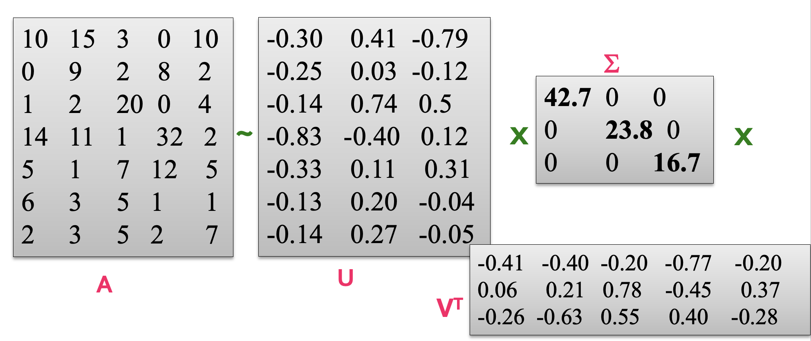
Review: SVD as an embedder
Similarly we can compute term (word) embeddings
<term, u1> = <[10,0,1,14,5,6,2] , u1>= -3.9
word

Slide 19
Review: SVD as an embedder
Similarly we can compute term (word) embeddings
<term, u1> = <[10,0,1,14,5,6,2] , u1>= -3.9
<term, u2> = <[10,0,1,14,5,6,2] , u2> = -12.19
term

Slide 20
Review: SVD as an embedder
Similarly we can compute term (word) embeddings
<term, u1> = <[10,0,1,14,5,6,2] , u1>= -3.9
<term, u2> = <[10,0,1,14,5,6,2] , u2> = -12.19
<term, u3> = <[10,0,1,14,5,6,2] , u3>= -3.4
term

Slide 21
Review: SVD as an embedder
Similarly we can compute term (word) embeddings
<term, u1> = <[10,0,1,14,5,6,2] , u1>= -3.9
<term, u2> = <[10,0,1,14,5,6,2] , u2> = -12.19
<term, u3> = <[10,0,1,14,5,6,2] , u3>= -3.4
term
emb1 = [-3.9, -12.19, -3.4]

Slide 22
Review: SVD as an embedder
SVD is impractical on real-world datasets
There are 0.5 billion wiki pages, and 4 billion words.
SVD is computationally prohibitive, as it requires to load all data in memory
SVD is a linear embedder
Not utilizing sparsity
Orthonormality constraint is an overkill
Notes:
It is a task independent embedder
Note if term-document matrix was populated as a binary matrix (capturing existence or absence of words in documents) then SVD would create embeddings would be of low quality.

Slide 23
From SVD to Neural Networks
State of the art embedders are among neural networks
Can we use neural networks to create non-linear embedding?

Slide 24
Neural Networks Fundamentals

Slide 25
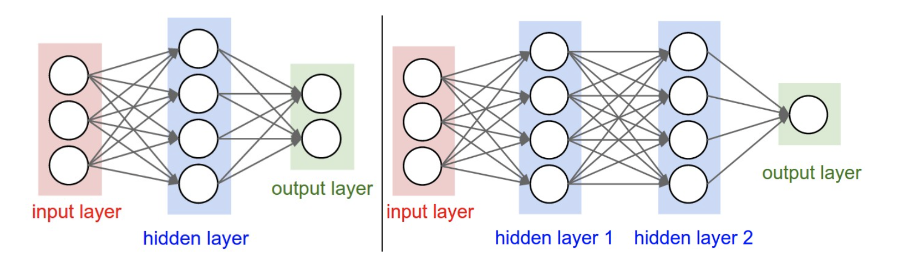
Neural Network: Architecture
A neural network is a collection of neurons that are connected in an acyclic graph
Outputs of some neurons are inputs to other neurons, and they are organized into layers
credit: cs231
Notes:
https://cs231n.github.io/neural-networks-1/#nn

Slide 26
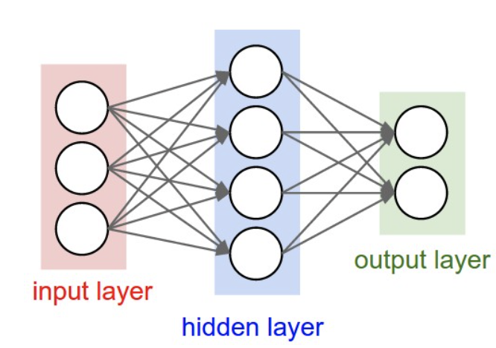
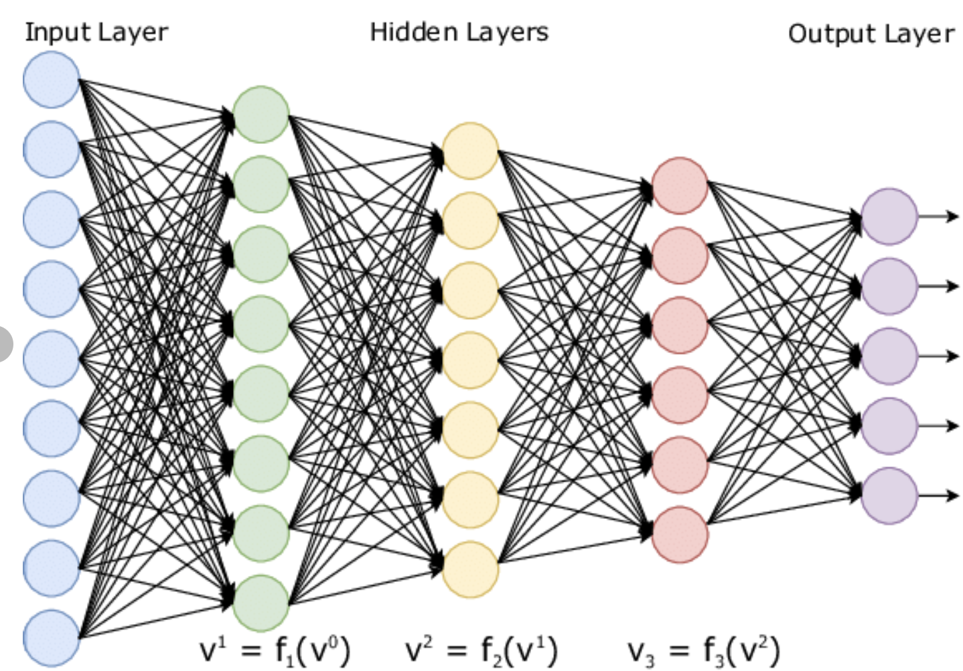
Neural Network
Fully-connected layer is the most common layer type:
neurons between two adjacent layers are fully pairwise connected
neurons within a single layer share no connections
Number of hidden layers and neurons in each hidden layer are hyperparameters of the network

Slide 27
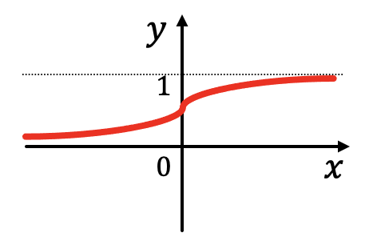


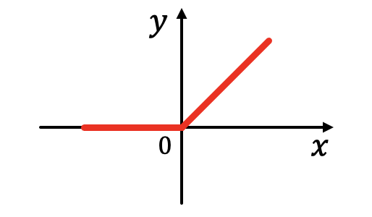

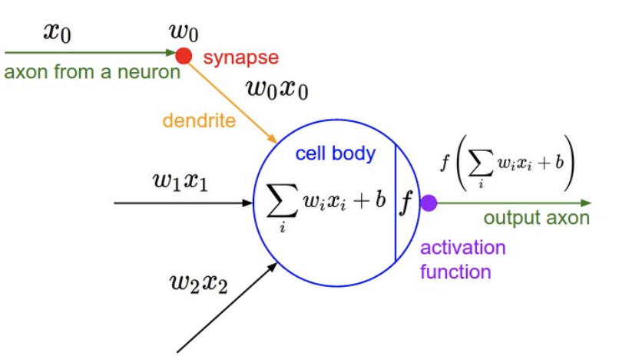


Neural Network: A Neuron
$f$is the activation function, It takes a single number and performs an operation on it. Some choices are:
Sigmoid
Tanh
Relu
A neuron is a classifier
Input: [x₀, x₁, x₂]
Output = $f\left(\sum{wixi+b}\right)$
Each neuron performs a dot product with the input and its weights, adds the bias and applies the activation function
credit: cs231
Notes:
Activation functions are also typically differentiable, meaning the first-order derivative can be calculated for a given input value
The choice of activation function has a large impact on the capability and performance of the neural network
although networks are designed to use the same activation function for all nodes in a layer.
All hidden layers typically use the same activation function. The output layer will typically use a different activation function from the hidden layers and is dependent upon the type of prediction required by the model.
The choice of activation function in the hidden layer will control how well the network model learns the training dataset. The choice of activation function in the output layer will define the type of predictions the model can make.

Slide 28


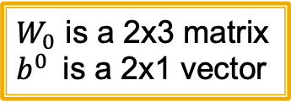




Neural Network: A Layer
Consider two neurons in a hidden layer
Each layer computes
$W_{l}$ is weight matrix that transforms representation at layer $l$ to layer $l+1$
$b^{l}$ is bias at layer $l$, and is added to the linear transformation of $x$
$σ$ is sigmoid activation function
hidden
layer
Input layer
$W_{1}$ is a 1x2 matrix
$$x_{1}$$
$$x_{2}$$
1-dimensional output
$$x_{3}$$
$W_{0}$ is a 2x3 matrix
$b^{0}$is a 2x1 vector
$$x^{(l+1)}=σ({W_{l}x}^{\left(l\right)}+b^{l})$$
Notes:
Each layer of MLP combines linear transformation and non-linearity:
First weight matrix is W_0 ?

Slide 29




Neural Network: A Layer
This network computes
Notice without activation functions, f(x) will be linear in x !!
$$f(x)=W1(σ\left({W_{0}x}^{\left(0\right)}+b^{0}\right)+b^{1})$$
hidden
layer
Input layer
$W_{1}$ is a 1x2 matrix
$$x_{1}$$
$$x_{2}$$
1-dimensional output
$$x_{3}$$
$W_{0}$ is a 2x3 matrix
$$f(x)={{W1W}_{0}x}^{\left(0\right)}+{W1b}^{0}+b^{1}$$

Slide 30
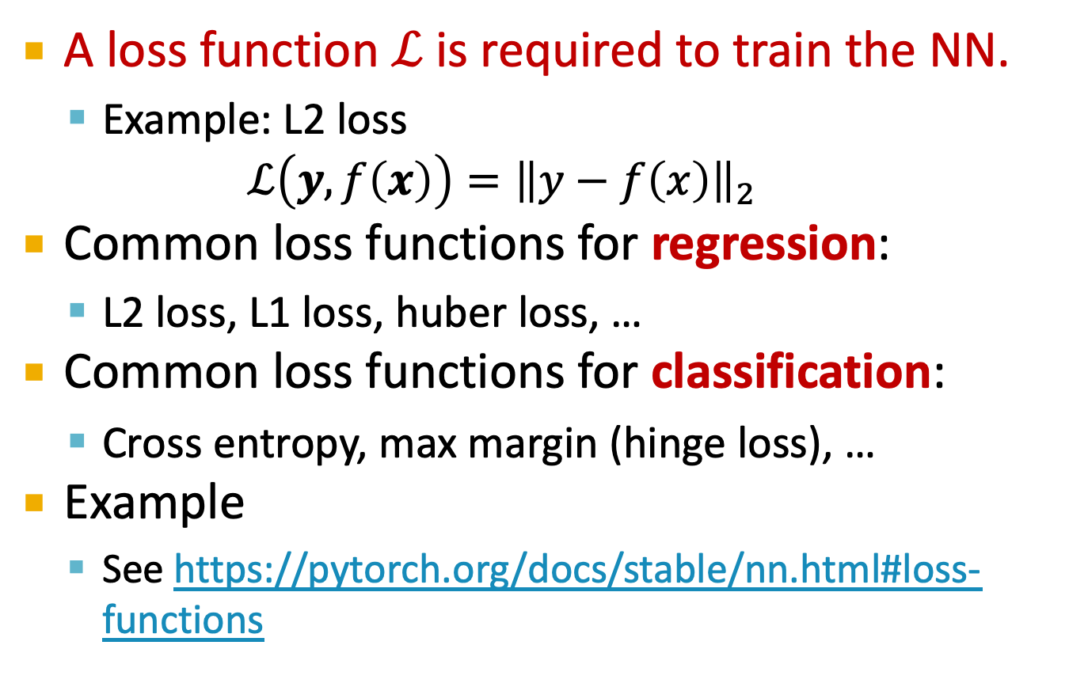
Neural Network: Loss Function
A loss function $ℒ$is required to train the NN.
Example: L2 loss $ℒ\left(y, f\left(x\right)\right)={\left\|y−f\left(x\right)\right\|}_{2}$
Common loss functions for regression:
L2 loss, L1 loss, huber loss, …
Common loss functions for classification:
Cross entropy, max margin (hinge loss), …
Example
See https://pytorch.org/docs/stable/nn.html#loss-functions
Notes:
Euclidean loss, absolute difference loss

Slide 31
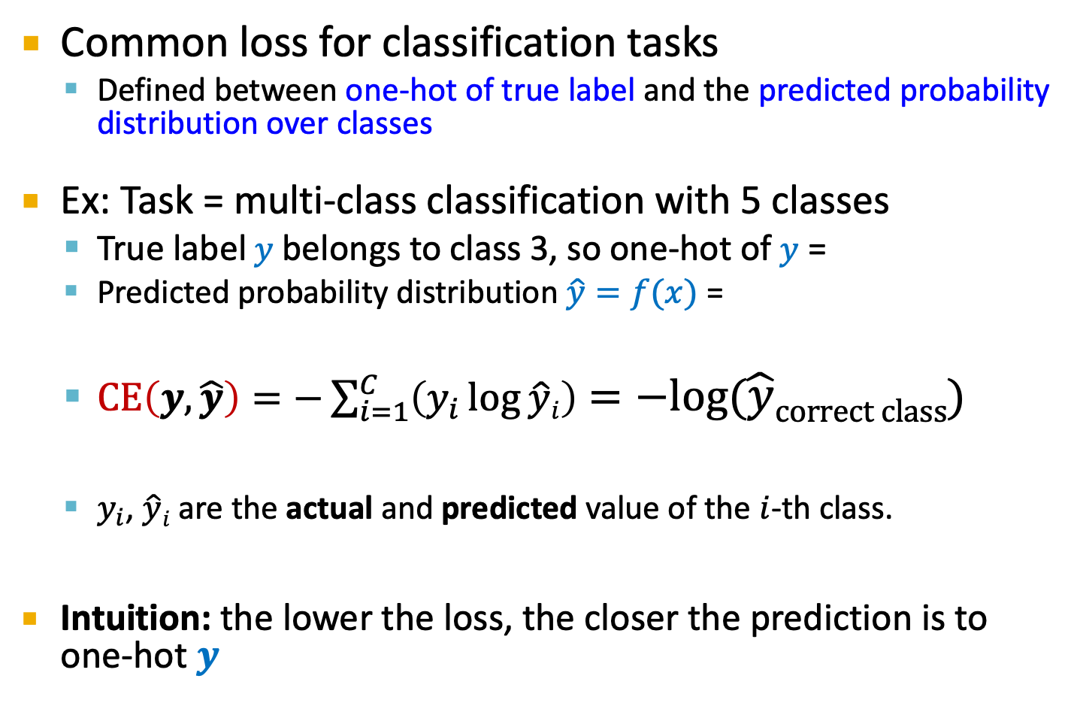
Cross Entropy Loss
Common loss for classification tasks
Defined between one-hot of true label and the predicted probability distribution over classes
Ex: Task = multi-class classification with 5 classes
True label $y$ belongs to class 3, so one-hot of $y$ =
Predicted probability distribution $\hat{y}=f(x)$ =
$CE\left(y,\hat{y}\right)=−\sum_{i=1}^{C}{\left(y_{i}\log{\hat{y}i}\right)}=−log⁡(\hat{y}correct class)$
$y_{i}$, $\hat{y}i$ are the actual and predicted value of the $i$-th class.
Intuition: the lower the loss, the closer the prediction is to one-hot $y$
0 | 0 | 1 | 0 | 0
0.1 | 0.3 | 0.4 | 0.1 | 0.1
Notes:
Classification tasks. Predicting what animal a given image is.

Slide 32
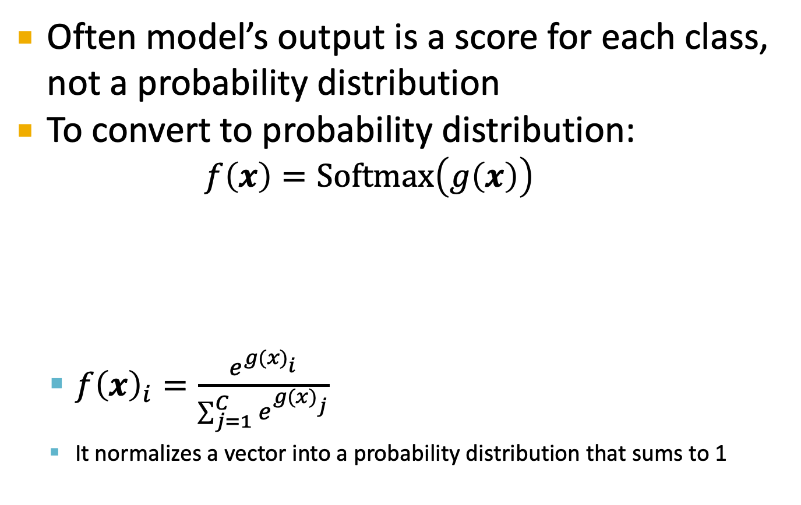
Cross Entropy Loss
Often model’s output is a score for each class, not a probability distribution
To convert to probability distribution:
$$f\left(x\right)=Softmax\left(g\left(x\right)\right)$$
$f{\left(x\right)}_{i}=\frac{e^{{g(x)}_{i}^{ }}}{\sum_{j=1}^{C}{e^{{g(x)}_{j}^{ }}}}$
It normalizes a vector into a probability distribution that sums to 1
Output score for each class
Probability distribution over classes
Cross entropy loss sometimes is referred to as softmax loss
Notes:
G(x) gets feature vector x, transform it hwoever it wants, computes a real value for every class
It exponentiates the values and sum it to 1.

Slide 33

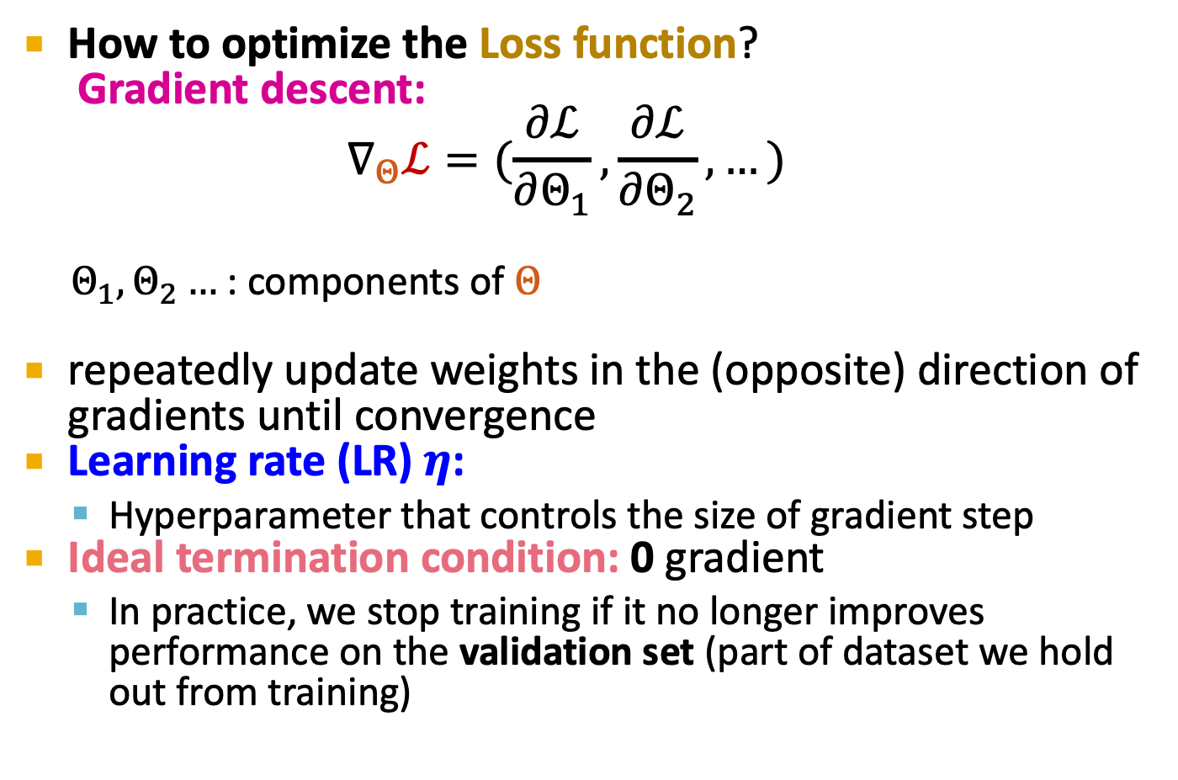
Neural Network: Training
How to optimize the Loss function?
Gradient descent: $$∇_{Θ}ℒ=(\frac{∂ℒ}{∂Θ_{1}},\frac{∂ℒ}{∂Θ_{2}}, …)$$
$Θ_{1},Θ_{2}…$ : components of $Θ$
repeatedly update weights in the (opposite) direction of gradients until convergence
Learning rate (LR) $η$:
Hyperparameter that controls the size of gradient step
Ideal termination condition: 0 gradient
In practice, we stop training if it no longer improves performance on the validation set (part of dataset we hold out from training)
Partial derivative
$$Θ←Θ−η∇_{Θ}ℒ$$

Slide 34
Neural Network
There are much more about NN including:
Minibatch Stochastic gradient descent
Batch size, Epoch
Learning rate scheduling
Optimizers to improve over SGD
However they are not the focus of today’s lecture.
Now that we know fundamentals, let’s use NN to learn embeddings

Slide 35
Learning Embeddings using Neural Networks

Slide 36
Task Independent Embedding
Word Embedding
Many techniques:Word2Vec, Glove, BERT, fastText
Today’s lecture: Word2Vec
Word2Vec was Developed at Google in 2013(paper)
Word2Vec is a statistical method
Very efficiently in learning word embedding
It is self-supervised, and task independent.

Slide 37
Word2Vec
Word2Vec comes in two architectures:
Continuous bag of words (CBOW)
Skip Gram
(We will discuss skip-gram model today)
The two methods are very similar, both use a shallow neural network (only 1 hidden layer) to learn word representations.
The key idea of word2Vec is that words with similar context have similar meanings.
It learns embedding based on the usage of words.

Slide 38
Word2Vec: target and context
The key idea: The more often a word appears in the context of certain other words, the closer they are in meaning.
Given a document, we can slide the window from left to right and find all pairs of (target, context) words
This is how we define context:
Given a document, set the window size=N. Window size is a hyperparameter.
For any given word (call it “target word”), N words to its left & N words to its right are the “context words”.
Document “I read sci-fi books”, and window size = 2
Target = “I” → context words = “read” , “sci-fi” .
Target = “read” → context words = “I” , “sci-fi”, “books”

Slide 39
Word2Vec: target and context
Document: “I read sci-fi books and drink orange juice”. Let window size = 2
The highlighted word is the target word. Other words in the box are context words.
I | read | sci-fi | books | and | drink | orange | juice
I | read | sci-fi | books | and | drink | orange | juice
I | read | sci-fi | books | and | drink | orange | juice
I | read | sci-fi | books | and | drink | orange | juice
I | read | sci-fi | books | and | drink | orange | juice
I | read | sci-fi | books | and | drink | orange | juice
I | read | sci-fi | books | and | drink | orange | juice
I | read | sci-fi | books | and | drink | orange | juice

Slide 40
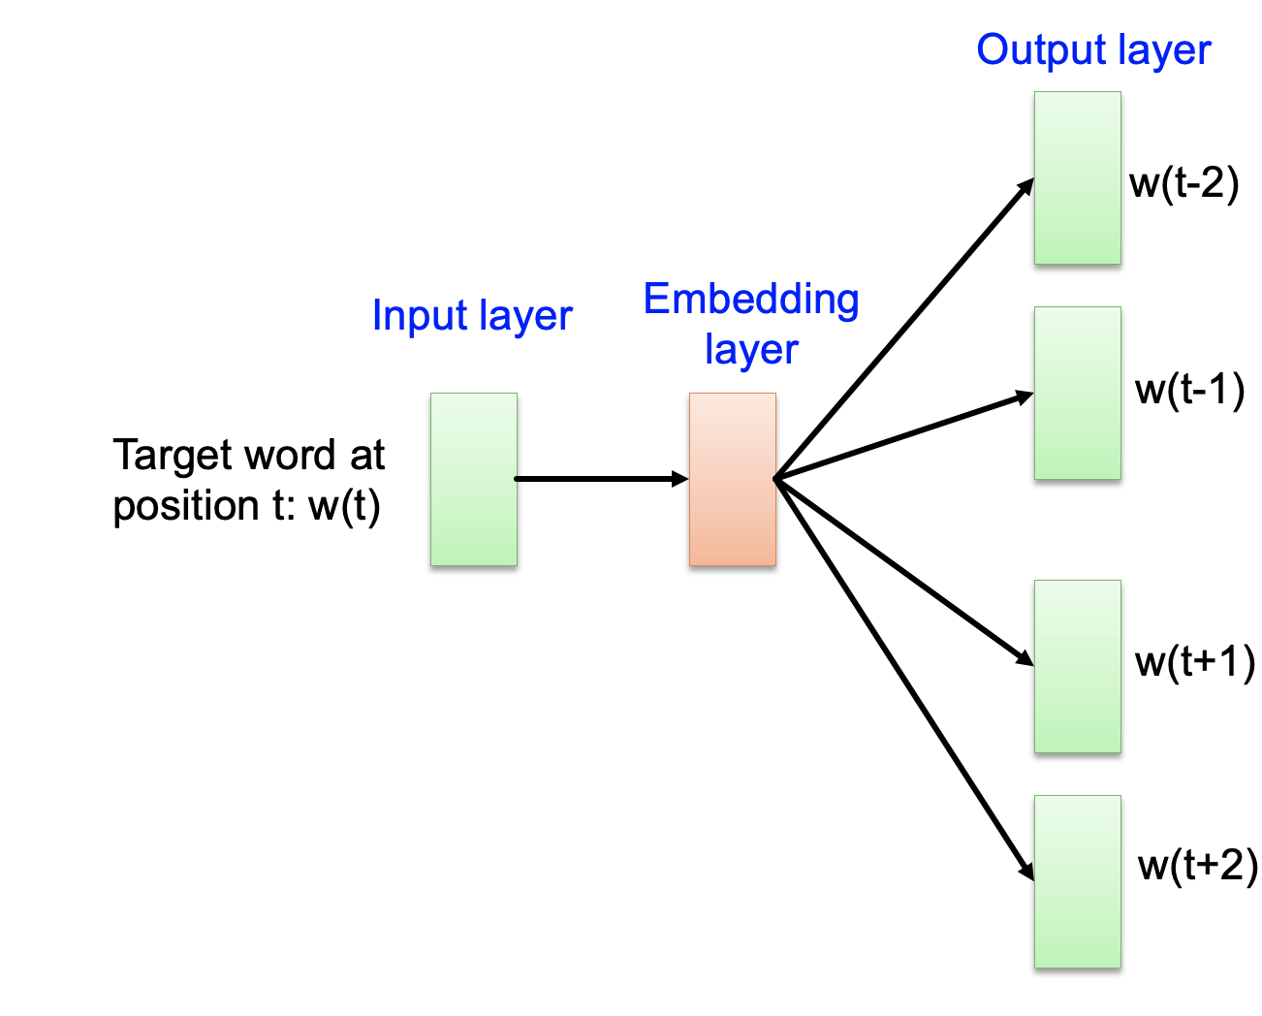
Word2Vec: architecture
Word2Vec is a 2 layers NN
Given the target word as input,
it predicts context words
In our example, if target word = “I” → context = “read”, “sci-fi”
Why is it called Skip-Gram?
window size = N, the model predicts the N-grams words except the current word as it is the input to the model, hence the name skip-gram.
Notes:
The point of the hidden layer is to map the words into a lower dimensionality while maintaining separation between dissimilar words. Most activation functions involve some "squishing" of space in one region and "expanding" of space in the other -- e.g., sigmoid/tanh will "squish together" all values < -1, and same with all values >1. ReLU would "squish together" all values <0, eliminating half of the representative capacity. As you can see, this actually hurts the separation quality, reducing the amount of "word mapping space" available

Slide 41
Word2Vec: high level architecture
Output layer
Set window size = 2
w(t-2)
Context words in history (left of target)
Embedding layer
Input layer
w(t-1)
Target word at position t: w(t)
w(t+1)
Given the word at position t, it predicts the nearby context words both from past and future.
** For simplicity, in this lecture we predict only one context word.
Context words in future (right of target)
w(t+2)

Slide 42
Word2Vec: high level architecture
Output layer
Set window size = 2
w(t-2)
Context words in history (left of target)
Embedding layer
Input layer
w(t-1)
Target word at position t: w(t)
w(t+1)
Given the word at position t, it predicts the nearby context words both from past and future.
** For simplicity, in this lecture we predict only one context word.
Context words in future (right of target)
w(t+2)

Slide 43
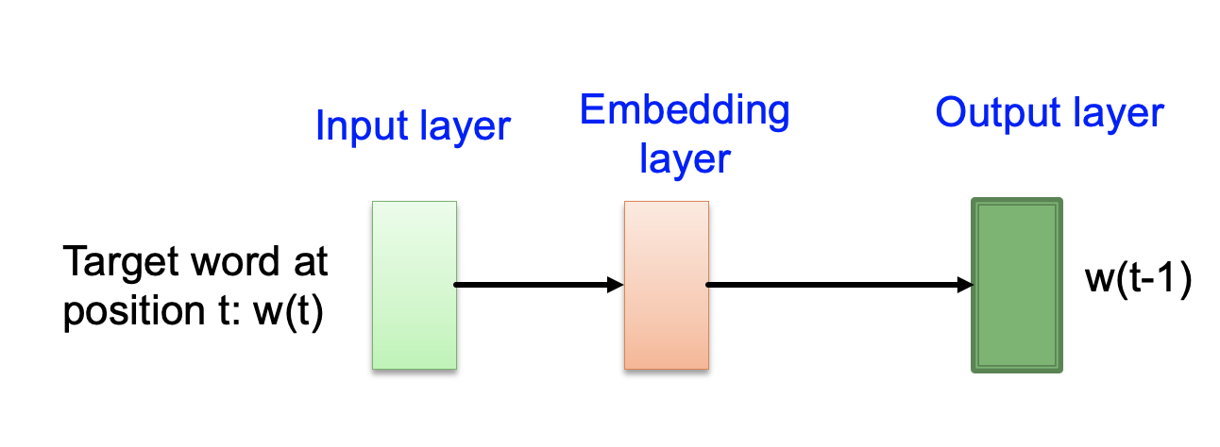
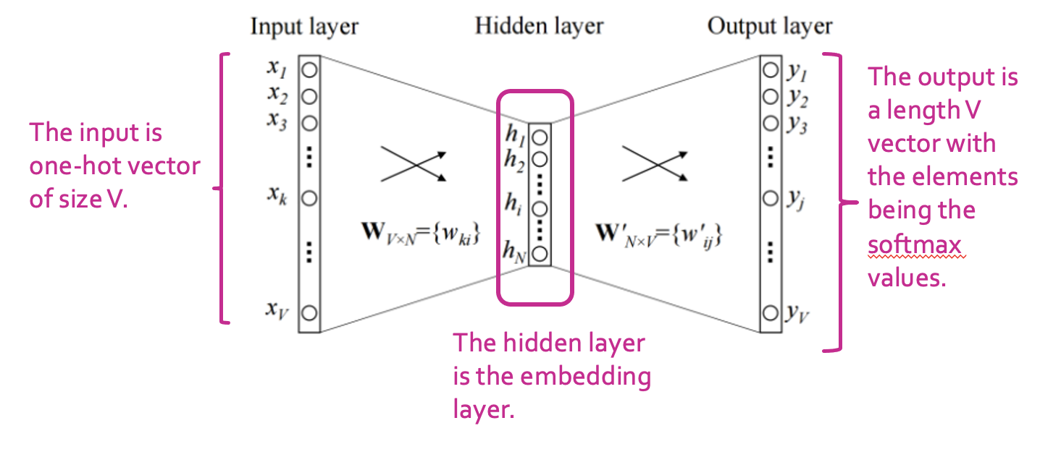
Word2Vec: architecture
Let V = size of vocabulary
Let N = embedding dimension
one-hot vector of context word: w(t-1)
one-hot vector of target word at position t: w(t)
Notes:
The point of the hidden layer is to map the words into a lower dimensionality while maintaining separation between dissimilar words. Most activation functions involve some "squishing" of space in one region and "expanding" of space in the other -- e.g., sigmoid/tanh will "squish together" all values < -1, and same with all values >1. ReLU would "squish together" all values <0, eliminating half of the representative capacity. As you can see, this actually hurts the separation quality, reducing the amount of "word mapping space" available

Slide 44
Word2Vec: architecture
A softmax function is applied on output layer
Probability that j-th word is in the context

Slide 45
Word2Vec: architecture
The hidden layer are all linear neurons, no activation!
Two different weight matrices:
W_{VxN} : from input to hidden layer
W’_{NxV} : from hidden to output layer
Notes:
The point of the hidden layer is to map the words into a lower dimensionality while maintaining separation between dissimilar words. Most activation functions involve some "squishing" of space in one region and "expanding" of space in the other -- e.g., sigmoid/tanh will "squish together" all values < -1, and same with all values >1. ReLU would "squish together" all values <0, eliminating half of the representative capacity. As you can see, this actually hurts the separation quality, reducing the amount of "word mapping space" available
think a word2vec model is supposed to be a linear classifier. We want a model that can represent the relative meaning of words in an Euclidean, human-interpertable space. In that way, we can calculate distances between word vectors that are understandable and easy to interpret by us, humans.

Slide 46
Word2Vec: architecture
After training the network:
The embedding of a word is obtained by x^{T} W i.e. matrix multiplication between word’s one-hot vector and learned weights W_{VxN}
Notes:
The point of the hidden layer is to map the words into a lower dimensionality while maintaining separation between dissimilar words. Most activation functions involve some "squishing" of space in one region and "expanding" of space in the other -- e.g., sigmoid/tanh will "squish together" all values < -1, and same with all values >1. ReLU would "squish together" all values <0, eliminating half of the representative capacity. As you can see, this actually hurts the separation quality, reducing the amount of "word mapping space" available
think a word2vec model is supposed to be a linear classifier. We want a model that can represent the relative meaning of words in an Euclidean, human-interpertable space. In that way, we can calculate distances between word vectors that are understandable and easy to interpret by us, humans.

Slide 47
Word2Vec: Training the network
How is the network trained?
There are no labels. It is an unsupervised task (it is a statistical method based on co-occurrence of words in one window).
We therefore create a fake task!
Fake task = given a target word, predict its context words
Decisions to make:
How to make training data?
What is the loss function?

Slide 48
Word2Vec: Training data
Take all your corpus of data = {d₁, d₂, ....}
Millions of documents, wiki pages, blot posts, etc.
Tokenize all documents and build vocabulary
Many methods: wordpeice, BytePairEncoding (BPE)
Simplest method: k-gram
If you take k=1 and do tokenization by words then 1-gram is equivalent to split sentences by words

Slide 49
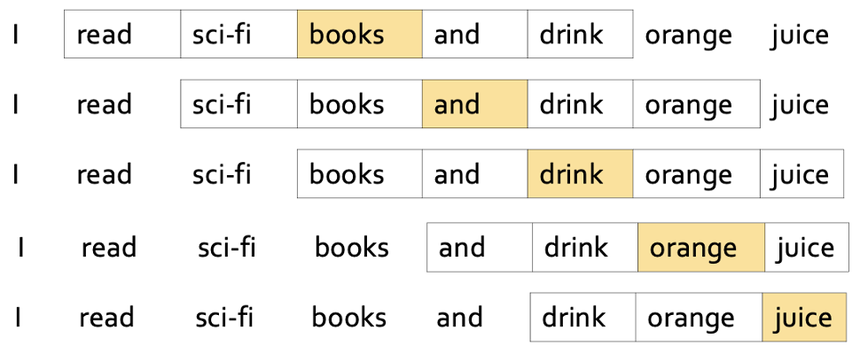
Word2Vec: Training data
Move sliding window over tokenized documents and collect training data
Ex: Document = {I read sci-fi books and drink orange juice}
Input document (window size = 2)
Training data (target, context)
(I, read) (I, sci-fi)
(read, I) (read, sci-fi) (read, books)
(sci-fi, I) (sci-fi, read) (sci-fi, books)...
(books, read) (books, sci-fi) ...
(and, sci-fi) (and, books) (and, drink)
(drink, books) (drink, and) ....
(orange, drink) (orange, juice)
(juice, drink) (juice, orange)

Slide 50

Word2Vec: Loss function
Given the topology of the network, if x is the input and y is the output, then
We train against target-context pairs (w_{t}, w_{c})
The context word w_{c} represents the ideal prediction, given the target word w_{t}
W_{c} is represented as one-hot, i.e. it has value 1 at some position j and other positions are 0
$$y=softmax(W^{′}TWTx)$$
Position j
w_{c} = [0,0,0,...,1,0,0,0..,0]

Slide 51
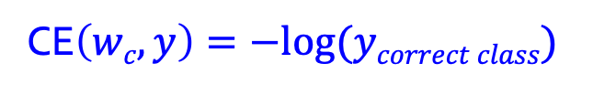

Word2Vec: Loss function
The loss function needs to evaluate the output layer at the same position j, i.e. y_{j}
(remember y is a probability distribution; ideal value of y_{j} is being 1)
We use cross-entropy loss function:
Since w_{c} = [0,0,0,...,1,0,0,0..,0]
And y = [0.02, 0.11,.... 0.8, 0, 0.031, ...]
the loss value would be
CE$\left(wc,y\right)=−log⁡(ycorrect class)$
Position j
$$L=−log⁡(0.8)$$
Notes:
The loss func is the quantity we want to minimize, given our training example, i.e., we want to maximize the probability that our model predicts the target word, given our context word.

Slide 52


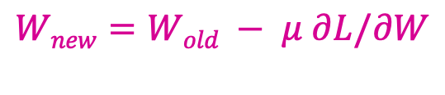
Word2Vec: Backpropagation
Now that loss function is clear, we want to find the values of W and W′ that minimize it.
We want our model to learn the weights.
We use gradient descent to tackle this
We find derivatives and and update weights as
$$∂L/∂W$$
$∂L/∂W$’
$$Wnew=Wold − μ ∂L/∂W$$

Slide 53
Word2Vec: Example
Document = {I read sci-fi books and drink orange juice}
Since this is only doc in our corpus, our vocab is
vocab = [“I”, “read”, ”sci-fi”, ”books”, “and”, “drink”, “orange”, “juice”] and V = 8
We execute one forward pass using above document
Step 1: assign one-hot vectors to words
I : [1, 0, 0, 0, 0, 0, 0, 0]
read : [0, 1, 0, 0, 0, 0, 0, 0]
sci-fi : [0, 0, 1, 0, 0, 0, 0, 0]
books : [0, 0, 0, 1, 0, 0, 0, 0]
and : [0, 0, 0, 0, 1, 0, 0, 0]
drink : [0, 0, 0, 0, 0, 1, 0, 0]
orange : [0, 0, 0, 0, 0, 0, 1, 0]
juice : [0, 0, 0, 0, 0, 0, 0, 1]

Slide 54
Word2Vec: Example
size of vocabulary = 8, Let’s set embedding dim = 3
Output layer: probability of each word being in context
Input layer : one-hot vector of target word
3-dim embedding

Slide 55
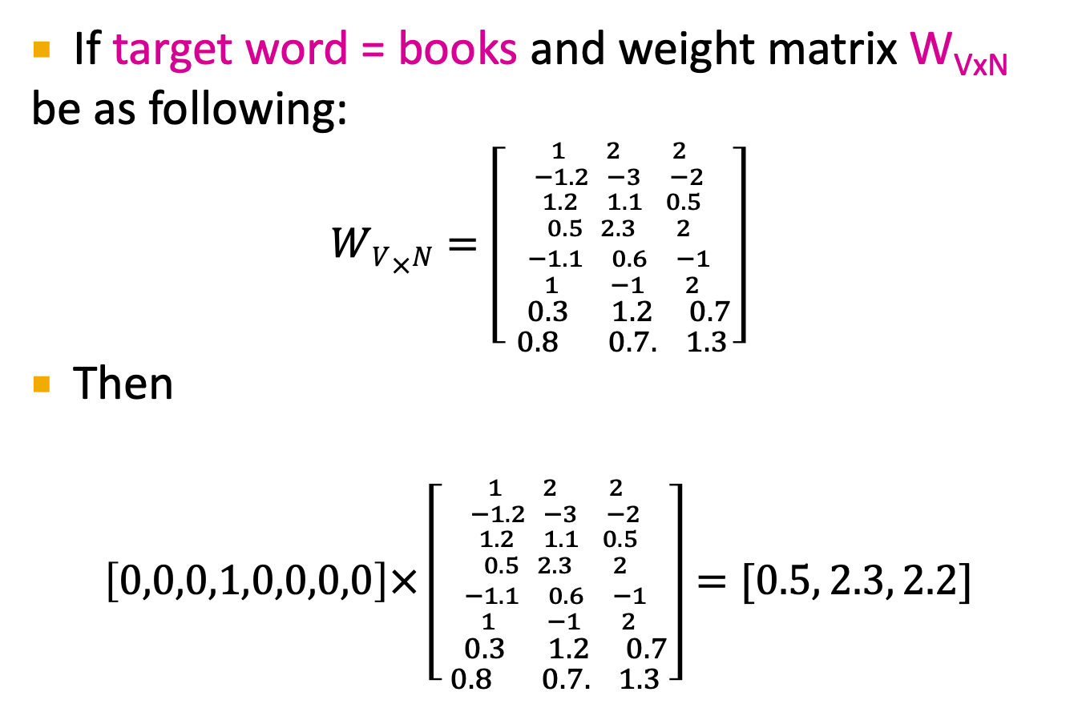
Word2Vec: Example
If target word = books and weight matrix W_{VxN}
be as following:
$$WV×N=\left[{{{1 2 2 \atop −1.2 −3 −2} \atop { 1.2 1. 1 0.5 \atop 0.5 2.3 2}} \atop {{−1. 1 0.6 −1 \atop 1 −1 2} \atop \begin{aligned} 0.3 1. 2 0.7 \\ 0.8 0.7. 1.3\end{aligned}}}\right]$$
Then
$$\left[0,0,0,1,0,0,0,0\right]×\left[{{{1 2 2 \atop −1.2 −3 −2} \atop { 1.2 1. 1 0.5 \atop 0.5 2.3 2}} \atop {{−1. 1 0.6 −1 \atop 1 −1 2} \atop \begin{aligned} 0.3 1. 2 0.7 \\ 0.8 0.7. 1.3\end{aligned}}}\right]=[0.5, 2.3, 2.2]$$

Slide 56
Word2Vec: Example
If target word =books, and W_{VxN} given:
0
W_{VxN}
0
0.5
Output layer: probability of each word being in context
0
Target word = books
1
2.3
0
0
2.2
0
0
3-dim embedding

Slide 57
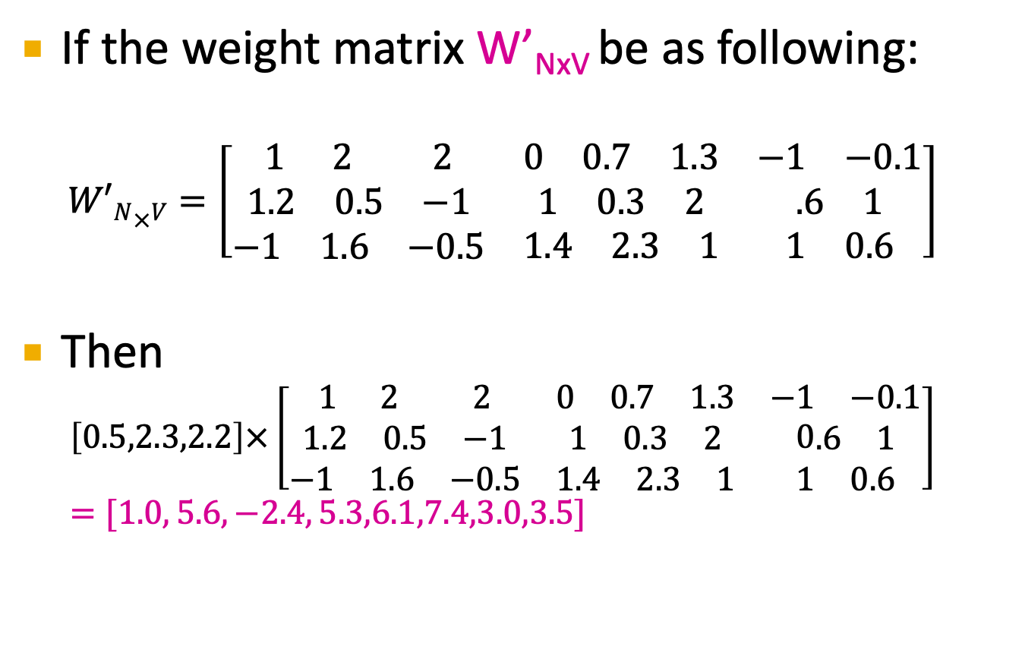
Word2Vec: Example
If the weight matrix W’_{NxV} be as following:
$$W′N×V=\left[\begin{matrix}\begin{matrix}1 & 2 & 2\end{matrix} & \begin{matrix}0 & 0.7 & 1.3\end{matrix} & \begin{matrix}−1 & −0.1\end{matrix} \\ \begin{matrix}1.2 & 0.5 & −1\end{matrix} & \begin{matrix}1 & 0.3 & 2\end{matrix} & \begin{matrix}.6 & 1\end{matrix} \\ \begin{matrix}−1 & 1.6 & −0.5\end{matrix} & \begin{matrix}1.4 & 2.3 & 1\end{matrix} & \begin{matrix}1 & 0.6\end{matrix}\end{matrix}\right]$$
Then
$$\left[0.5,2.3,2.2\right]×\left[\begin{matrix}\begin{matrix}1 & 2 & 2\end{matrix} & \begin{matrix}0 & 0.7 & 1.3\end{matrix} & \begin{matrix}−1 & −0.1\end{matrix} \\ \begin{matrix}1.2 & 0.5 & −1\end{matrix} & \begin{matrix}1 & 0.3 & 2\end{matrix} & 0\begin{matrix}.6 & 1\end{matrix} \\ \begin{matrix}−1 & 1.6 & −0.5\end{matrix} & \begin{matrix}1.4 & 2.3 & 1\end{matrix} & \begin{matrix}1 & 0.6\end{matrix}\end{matrix}\right]=[1.0, 5.6,−2.4, 5.3,6.1,7.4,3.0,3.5]$$

Slide 58
Word2Vec: Example
If W’_{NxV} given:
0
1.0
W_{VxN}
W’_{NxV}
0
5.6
0.5
0
-2.4
Target word = books
1
5.3
2.3
0
6.1
0
7.4
2.2
0
3
0
3-dim embedding
3.5

Slide 59
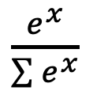
Word2Vec: Example
If W’_{NxV} given:
0
1.0
W_{VxN}
W’_{NxV}
0
5.6
0.5
We apply softmax functions to turn them into probabilities.
Each output
neuron x =
0
-2.4
Target word = books
1
5.3
2.3
0
6.1
0
7.4
2.2
0
3
0
3-dim embedding
3.5

Slide 60
Word2Vec: Example
Probability distribution of context word
If W’_{NxV} given:
0
1.0
0.001
W_{VxN}
W’_{NxV}
0
5.6
0.104
0.5
0
-2.4
0
Target word = books
1
5.3
2.3
0.077
0
6.1
0.177
0
7.4
0.627
2.2
0
3
0.008
0
3-dim embedding
3.5
0.013

Slide 61
Word2Vec: Example
One-hot of context
If W’_{NxV} given:
probabilities
0
1.0
0.001
0
W_{VxN}
W’_{NxV}
0
5.6
0
0.104
0.5
0
-2.4
0
0
Target word = books
1
5.3
0
2.3
0.077
0
6.1
0
0.177
0
7.4
1
2.2
0.627
0
3
0
0.008
0
3-dim embedding
3.5
0
0.013

Slide 62
Word2Vec: Example
One-hot of context
If W’_{NxV} given:
probabilities
0
1.0
0.001
0
W_{VxN}
W’_{NxV}
0
5.6
0
0.104
0.5
0
-2.4
0
0
Target word = books
1
5.3
0
2.3
0.077
0
6.1
0
0.177
1
0
7.4
0.627
drink
2.2
0
3
0
0.008
0
3-dim embedding
3.5
0
0.013

Slide 63
Word2Vec: Example
The network learns by comparing softmax vector to the one-hot of true context word.
In our example target = “books”, one correct context =“read” but we predicted “drink”
Predicted vector = [0.001,0.104,0,0.077,0.177,0.627,0.008,0.013]
One-hot of “read”= [0,1,0,0,0,0,0,0]
Then
$$L=−\ln\left(0.104\right)=2.26$$

Slide 64
Word2Vec: Summary
Word2Vec comes in two architecture:
CBOW: Given context words, it predicts target word
Skip-Gram: Given target word, predicts context words
Skip Gram method:
works well with small amount of data and is found to represent rare words well
CBOW method:
is faster and more suitable for large data, it has better representations for more frequent words.
Notes:
According to Mikolov,
https://towardsdatascience.com/introduction-to-word-embedding-and-word2vec-652d0c2060fa

